Slide 1
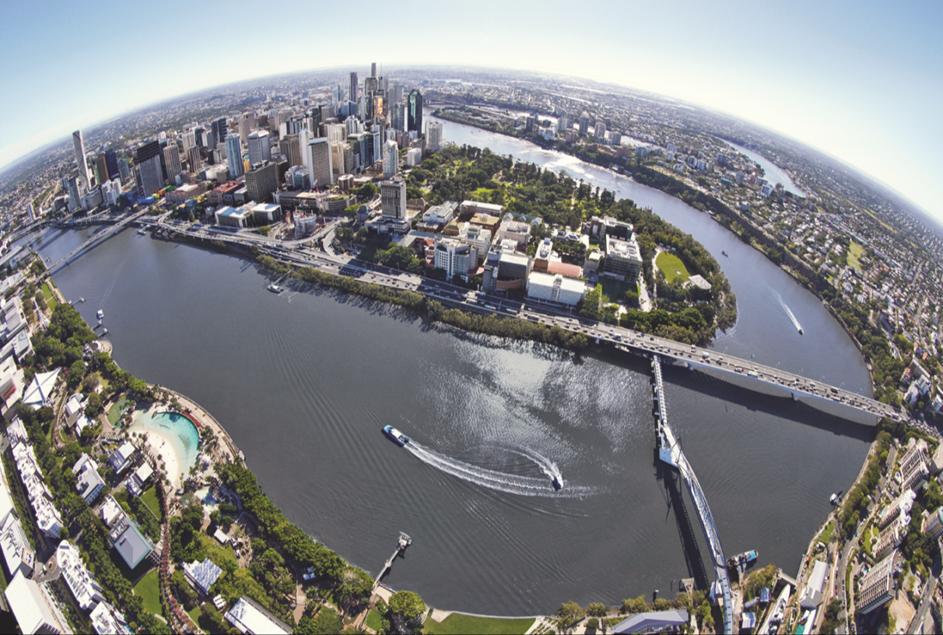
Basin-Connected Cities
International Water Association
Notes:
Allow for discussions under an extended scope to address the countries challenges in a broader water security context going beyond water services

Slide 2
“The battle for sustainability will be lost or won in cities…”
Notes:
Former Secretary General of the UN Ban Ki-moon, stated that:
The battle for sustainability will be won or lost in cities -

Slide 3
Urban water challenges
The rapid pace and scale of urbanization challenges the delivery of water and sanitation services and environmental protection.
Uncoordinated use of water & land resources leads to negative impacts on cities and watersheds
Notes:
What does this mean? Many challenges we face impact the cities where most of us live, for example the delivery of water and sanitation services. These challenges include
Increasing urbanisation. The UN indicated that by 2050, two out of every three people are likely to be living in cities or other urban centres
Disruption weather patterns due to climate change adding further uncertainty to long term planning
Growing demand will need to be managed carefully as population continue to grow
With this growth, there is also increased competition between different water users
With these challenges, uncoordinated use of water & land resources leads to negative impacts on cities and watersheds

Slide 4
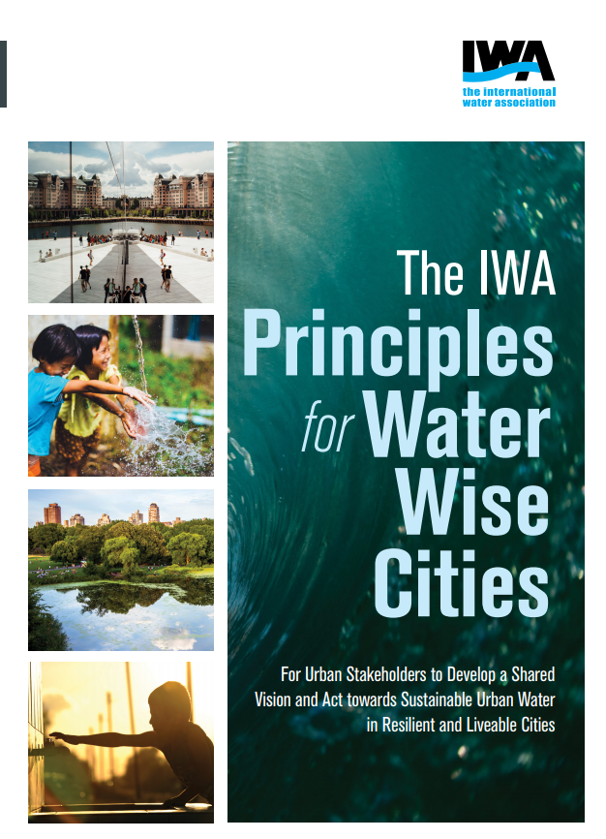
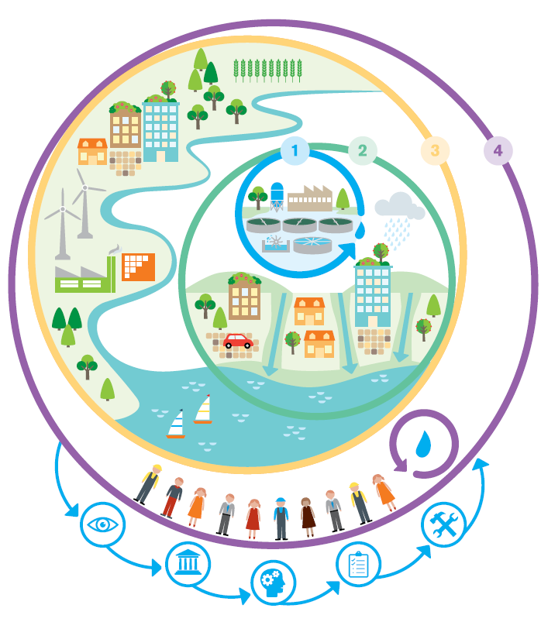
The IWA principles for water-Wise Cities
Regenerative Water Services
Water Sensitive Urban Design
Basin Connected Cities
Building water-wise communities
Notes:
These pressures and challenges highlights the need for more sustainable urban planning and public services, and at the same time, linkages between urban and rural areas will need to be strengthened by building on their existing economic, social and environmental ties.
The IWA Principles for Water Wise Cities provides a framework to encourage resilient planning and design for more liveable cities in the face of pressures such as climate change and population growth.
There are 4 levels of action which correspond to different scales:
Regenerative water services (water and wastewater services scale)
Water sensitive urban design (city scale)
Basin-connected cities (connection with watershed)
Building water-wise communities (professional capacity, citizen awareness)

Slide 5
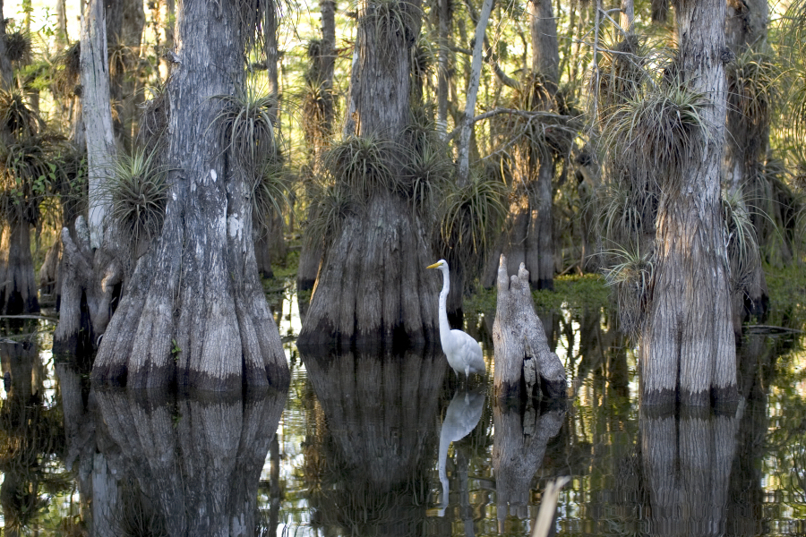
Basin-Connected cities – systems thinking to Achieve water security
Urban/Peri Urban
Energy & Industry
Reused Water
Co-digestion
(Biogas Production)
Water Efficiencies (+)
Flood Mitigation, GW Recharge
Pollution Reduction
Carbon Sequestration
GI reduces energy for water
Water Efficiencies (-)
Ecosystems
Agriculture
Notes:
The focus here is on the 3rd level of action – Basin-connected cities – linking to wider watershed. It puts emphasis on
The need to protect basins and restore those that are already degraded to ensure a balanced approach to development that sustains cities and the ecosystems they rely on
How a disruption in supply of freshwater resources to cities from their watershed can have significant economic, environmental and health consequences.
How impacts can be felt for energy and food supplies in addition to water supply for drinking
This slide shows examples of connections with the watersheds we rely on

Slide 6
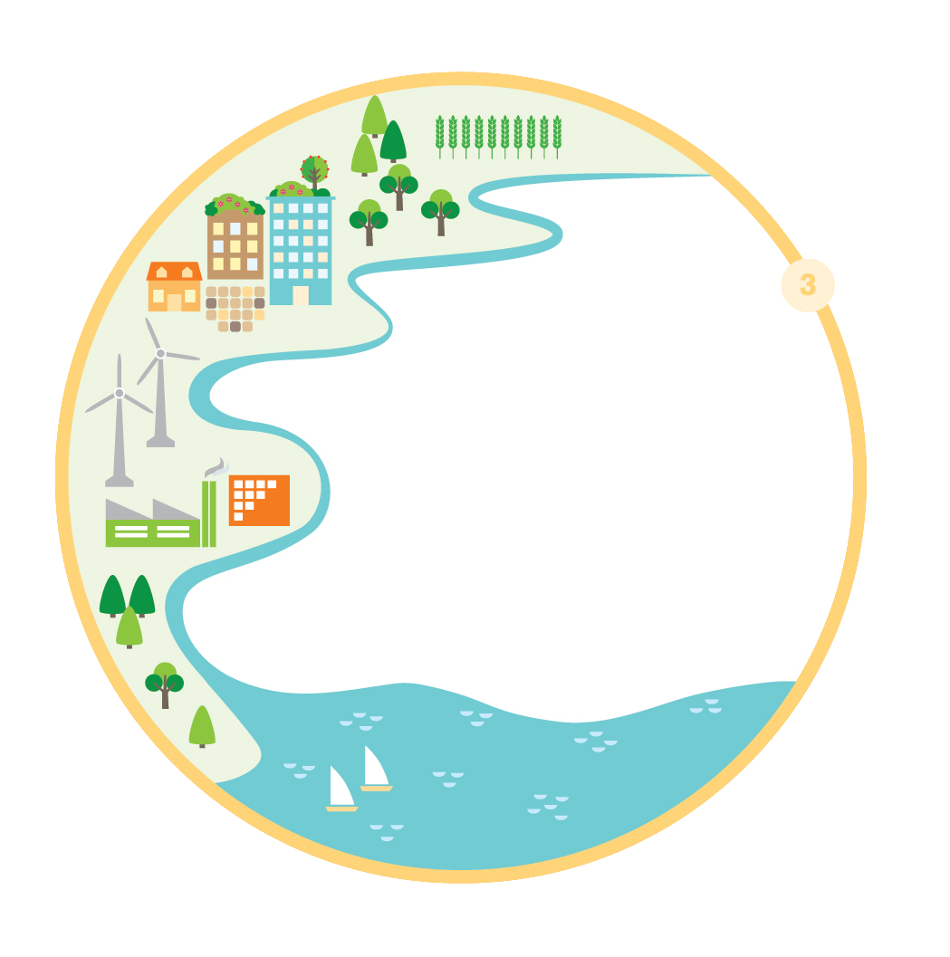
Rationale for Basin-Connected Cities
Protecting basins and restoring those that are already degraded is a priority to ensure a balanced approach to development that sustains cities and the ecosystems they rely on.
A disruption in supply of freshwater resources to cities can have significant economic, environmental and health consequences.
By proactively taking part in basin management, the city secures water, food and energy resources, protects water quality, and increases resilience to extreme events.
Notes:
Focus today is on 3rd level of action – Basin-connected cities – linking to wider watershed
Protecting basins and restoring those that are already degraded is a priority to ensure a balanced approach to development that sustains cities and the ecosystems they rely on. The Sustainable Development Goals (SDGs) focus on this, specifically through SDG6 which aims to ensure availability management of water and sanitation for all. Continuous socio-economic development for cities and industries within a catchment area requires water security which depends mainly on healthy basin ecosystems coupled with effective water governance. Urban stakeholders have a critical role to play in preserving the freshwater resources on which they depend. A disruption in supply of freshwater resources to cities can have significant economic, environmental and health consequences.

Slide 7
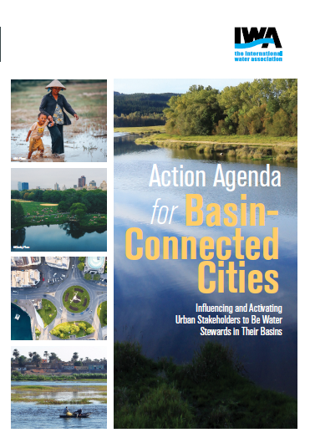
Action Agenda for basin connected cities
Aim is to influence and activate utilities, cities and their industries to become water stewards working with basin stakeholders.
Critical to encourage urban leaders to champion protection and management of water resources upstream and downstream by connecting with basin and catchment organisations
The Agenda provides a framework to achieve Basin-Connected Cities including:
Securing water resources
Protecting water quality
Preparing for extreme events
How can we achieve water security and build climate resilience within our watersheds in the coming decades ?
What actions by cities need to be taken today to achieve sustainable management of basins into the future?
Notes:
Action Agenda was developed with members over time through consultations, workshops and discussions.
The IWA Action Agenda for Basin Connected Cities was developed to influence and activate utilities, cities and their industries to become water stewards working with basin stakeholders. This is seen as critical to encourage urban leaders to champion protection and management of water resources upstream and downstream by connecting with basin and catchment organisations
The Agenda provides a framework to achieve Basin-Connected cities (stemming from the Principles) especially in regards to: securing water resources, protecting water quality, and preparing for extreme events.
The agenda provides a starting point to address the questions:
How can we achieve water security and build climate resilience within our watersheds in the coming decades?
What actions by cities (urban stakeholders) need to be taken today to achieve sustainable management of basins into the future?
The Action Agenda is essentially looking at water management from catchment to consumer but through an urban lens
In case you are asked:
Why the focus on connecting cities and utilities (and industry) with their basins? - There are numerous programmes addressing the challenges being tackled at the basin scale. A noticeable gap, however, is the active link from urban areas to their catchment areas. What can cities and their stakeholders do to improve their water sources?
Why does IWA has this focus? IWA is well placed to broker the link between the wider catchment organizations and authorities and cities, industries, and their water and wastewater utilities. IWA has a strong presence in the urban water sector through connections with urban water and wastewater utilities, technical experts across the urban and industrial water cycle as well as regulators and policy makers (e.g. from mayors to ministers).

Slide 8
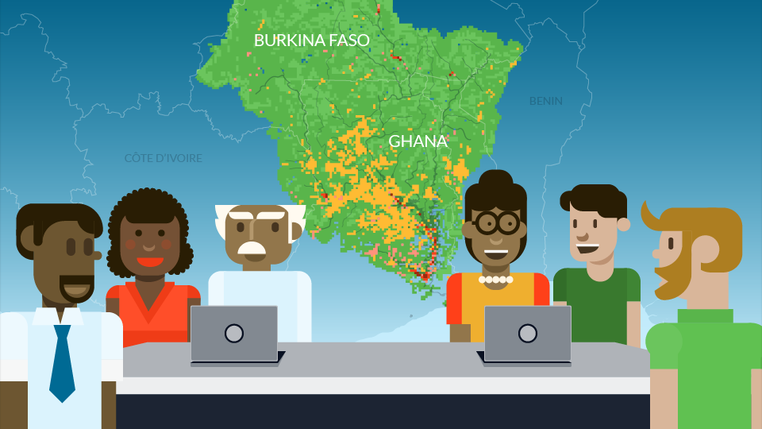
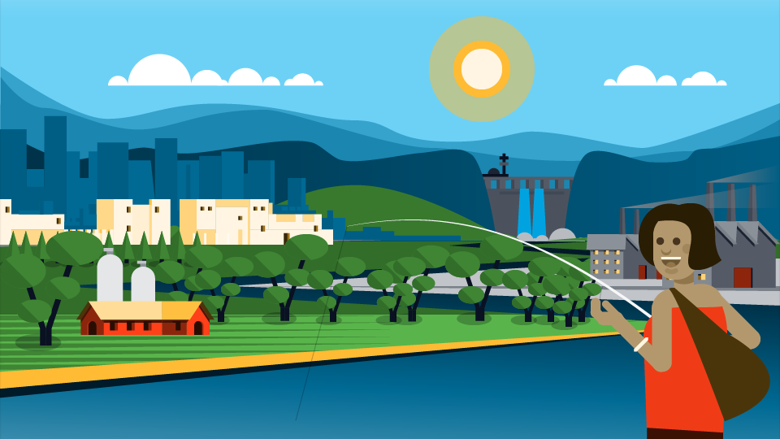
Link to IWRM
Improving water security and protecting water resources which cities rely on is a priority. This can be achieved by having an integrated water resources management (IWRM) approach with an emphasis on the urban-basin linkage.
IWRM provides a framework for planning and delivering water services in the wider basin (e.g. agriculture, energy, natural resource extraction) and the city (e.g. transport, energy, industry, etc).
Efficient, equitable resource sharing at the local level which is also environmentally sustainable must be in the context of wider basin planning and regulation.
IWRM can address the complexities of water problems, diverse stakeholder and sector perspectives, and their interdependence from catchment to consumer.
Notes:
The question is often asked how this links to IWRM. It is essentially looking at water management across from catchment to consumer but through an urban lens

Slide 9
Who is the target audience?
Primary
Secondary
Water and wastewater utilities
City governments
Industry (urban and peri-urban)
Policy makers and regulators
Basin organisations and water resource agencies
Agriculture
Energy
Natural resource extraction
Tourism
Notes:
Look at this through an urban lens but connect to basin level stakeholders
Not limited to these target audiences

Slide 10
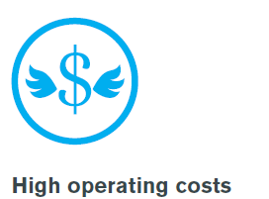
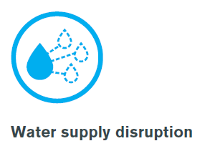
Action agenda for basin-Connected Cities
Drivers for Action
Pathways for Action
Foundations for Action
e.g.
e.g.
e.g.
Notes:
The Agenda outlines the rationale for urban stakeholders to lead the way in realizing their role as water stewards and the different pathways and activities towards achieving sustainable water management. This includes the Drivers for Action such as extreme events, declining water quality, and water availability; followed by the Pathways to Action through assessment, planning and implementation; and the Foundations for Action from developing a vision to building capacity to improving governance.

Slide 11
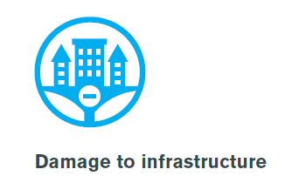
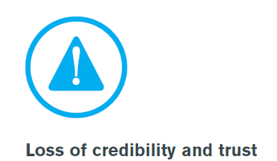
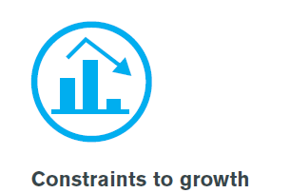
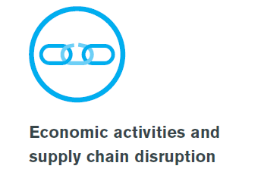
Drivers for Action - RISKS
Notes:
Examples of drivers for action (you can find more details in the Action Agenda):
Damage to infrastructure due to pressure of flooding and droughts events
Loss of credibility and trust because water service providers are unable to supply of safe drinking water due to contamination by other sectors
Declining quality of life due to inadequate response to water shortages
Etc.

Slide 12
Pathways for actions
What actions need to be taken by cities today to achieve sustainable management of basins into the future? The Basin Action Agenda provides a framework to inspire actions from cities and their stakeholders
Assessment
Planning
Implementation
Risk-based approach to planning
Integration of natural infrastructure
Investment in data & information systems
Water allocation mechanisms
Economic and financing mechanisms
Building partnerships from catchment to tap
Linking traditional water management with science
Stakeholder participation in planning and management
Aligning urban development with basin management
Digital Technologies
Invest in values to motivate water decision-making
Customisation of solutions
Notes:
You can look at the Action Agenda for more details, but essentially, this describes the various pathways that inspire stakeholders to take action and deal with water challenges in the wider catchment and play an essential role in ensuring water quality and quantity.
Examples:
Integration of natural infrastructure, for example, water funds set up with downstream users (utilities, municipality, industry) to invest in protecting the watershed.
Digital technologies such as the use of satellite technology to supplement data on what is happening upstream (potential risks – drought, floods, etc).
Stakeholder participation in planning and management to ensure common understanding, establish an enabling environment for change and awareness of economic opportunities.

Slide 13
Foundations for action
These are the foundations for the pathways to action to deliver sustainable urban water management. Cities and their stakeholders will be at different stages, from creating a joint vision to showcasing how they are implementing the connection between cities and basins.
Vision - A resilient city vision which includes the connection to the surrounding basin enables people to work together at different scales and across disciplines.
Governance - provides the framework for stakeholders to work together from catchment to tap to achieve a joint vision
Knowledge and capacities - understanding what are the current competencies and capacities for urban stakeholders to effectively contribute to basin management.
Planning tools - support the alignment of urban development and urban impacts with basin management.
Implementation tools - tools include approaches to put planning into action which improves water quantity and quality for water, food and energy security (e.g. regulation, economic incentives, technologies, etc)
Notes:
These foundations are aligned with the Principles for Water Wise Cities and adapted to fit into the basin-connected cities level

Slide 14
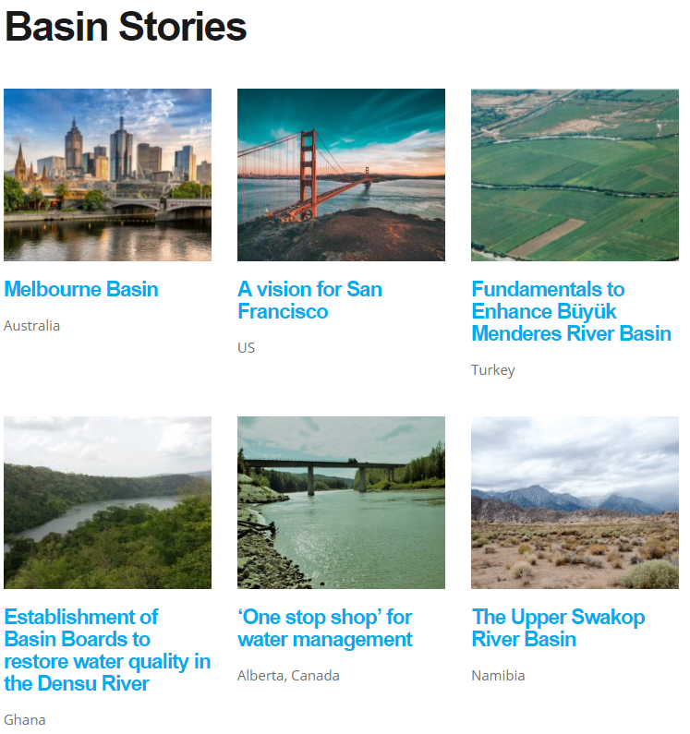
Next steps – Upscaling the Framework
Creating a handbook of cases and best practices using the framework.
Showcasing snapshots or Basin Stories of what IWA members and partners are doing on enabling Basin-Connected Cities (which can contribute to the above publication).
Working with the signatories of the Principles for Water Wise Cities to integrate the Action Agenda Framework into their urban water planning.
Empowering members and partners to localise the Action Agenda Framework and integrate into their planning, proposals, etc.
Translation of the Action Agenda – led by partners and members (ongoing in Chinese, Spanish, French and Portuguese).

Slide 15
For more information please visit:
http://www.iwa-network.org/projects/basin-action-agenda/
Katharine Cross
Katharine.cross@iwahq.org

Slide 16
